Slide 1
SMART LOCATION ALARM
SMART SOLUTION FOR MODERN LIVING

Slide 2
ABOUT OUR APP
Smart Location Alarm is a web application designed to enhance travel experiences by providing real-time notifications safety calling when users reach their destinations. Users input their destination and the app tracks their progress using GPS API. It offers notification,callings, integrates with mapping services, and sends alerts as the destination approaches. Overall, Smart Location Alarm simplifies travel and ensures users arrive at their destinations informed and on time..

Slide 3

GOALS & OBJECTIVES
01
The primary goal of Smart location Alarm is to enhance the overall travel experience for users by providing them with timely and relevant notifications and alarm as they reach their destinations.
02
To simplify the travel process by eliminating the need for users to constantly monitor their progress or check navigation apps during their journey.
03
To become a reliable companion for travelers, ensuring accurate notifications and smooth functionality to build trust among users.

Slide 4
Enhancing Travel Safety: The Need for Smart Location Alarms
01
Many existing travel safety systems offer limited options for user customization regarding arrival notifications, making it challenging for individuals to tailor alerts according to their preferences or specific needs.
02
Traditional safety measures often require manual activation or intervention by the user to trigger arrival notifications, which can be impractical or unsafe, especially while driving or navigating unfamiliar areas.
03
Understanding the limitations of traditional travel safety measures underscores the importance of innovative solutions like the Smart Location Alarm. By addressing the shortcomings of existing systems and offering precise, customizable arrival notifications, we can significantly enhance the safety and convenience of travelers worldwide.

Slide 5







Technologies used
BUILT USING MERN STACK

Slide 6
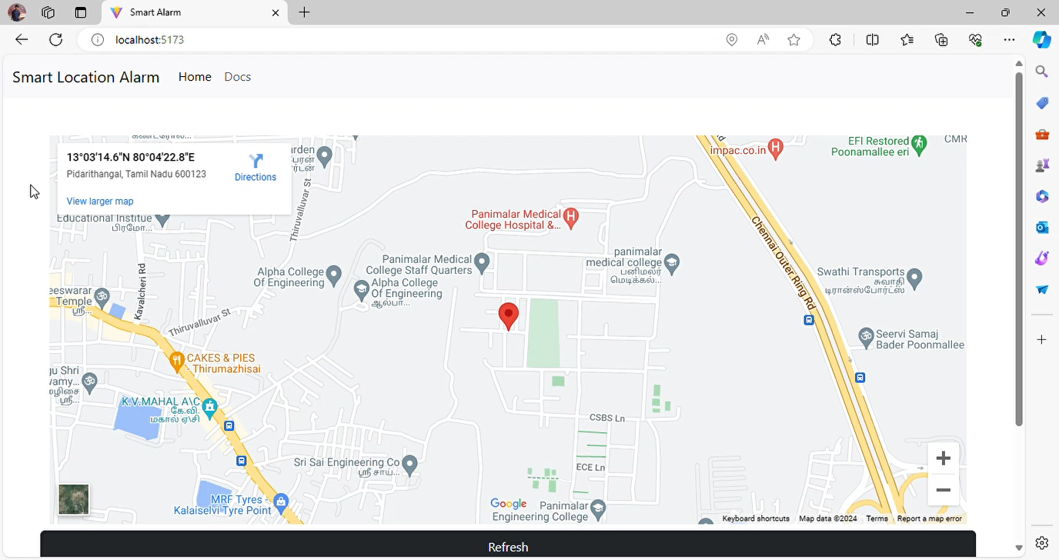
DEMO VIDEO

Slide 7
Features
Alert users by sending a notification (SMS) text when user is about to reach the destination
Make call to an mobile (user given) when destination is about to be reached.
Alert the user by ringing alarm when the destination is reached.
User friendly interface.
Accurate location monitoring (for every 60 seconds)

Slide 8
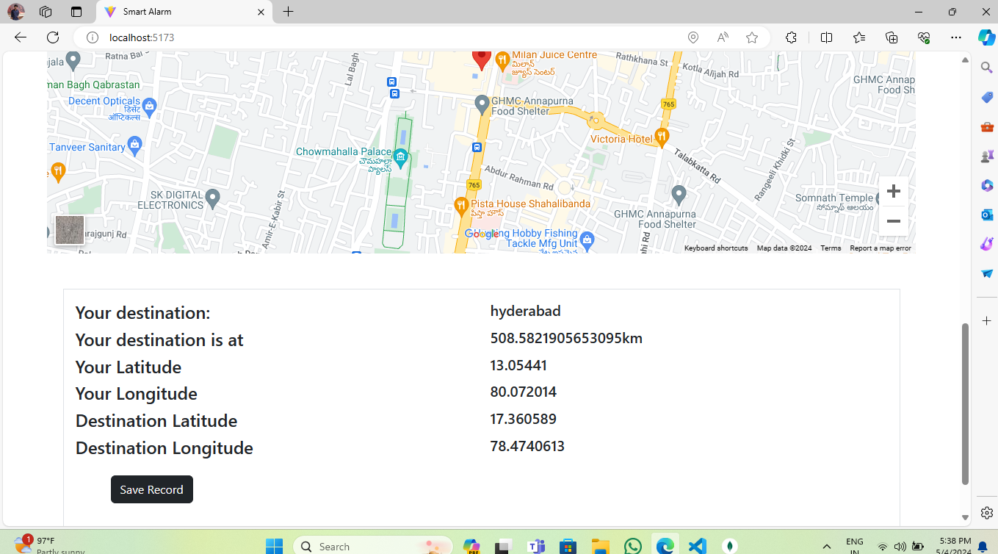
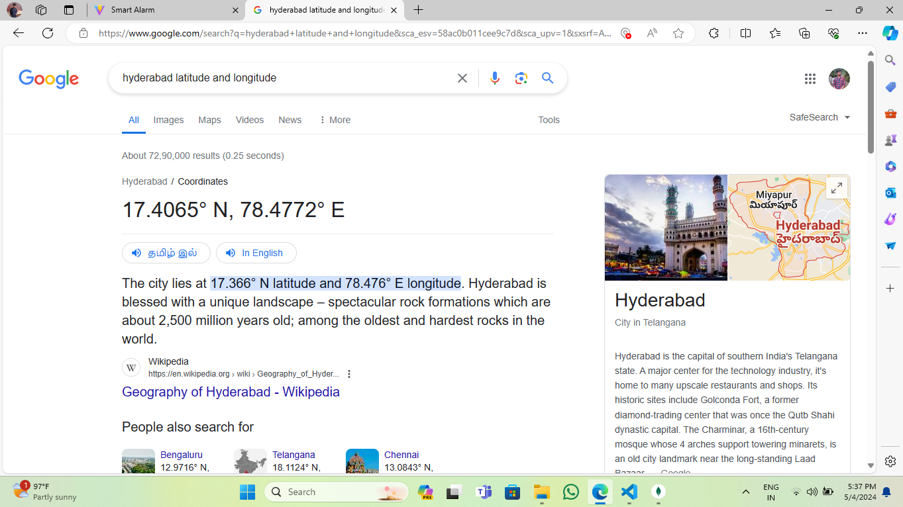
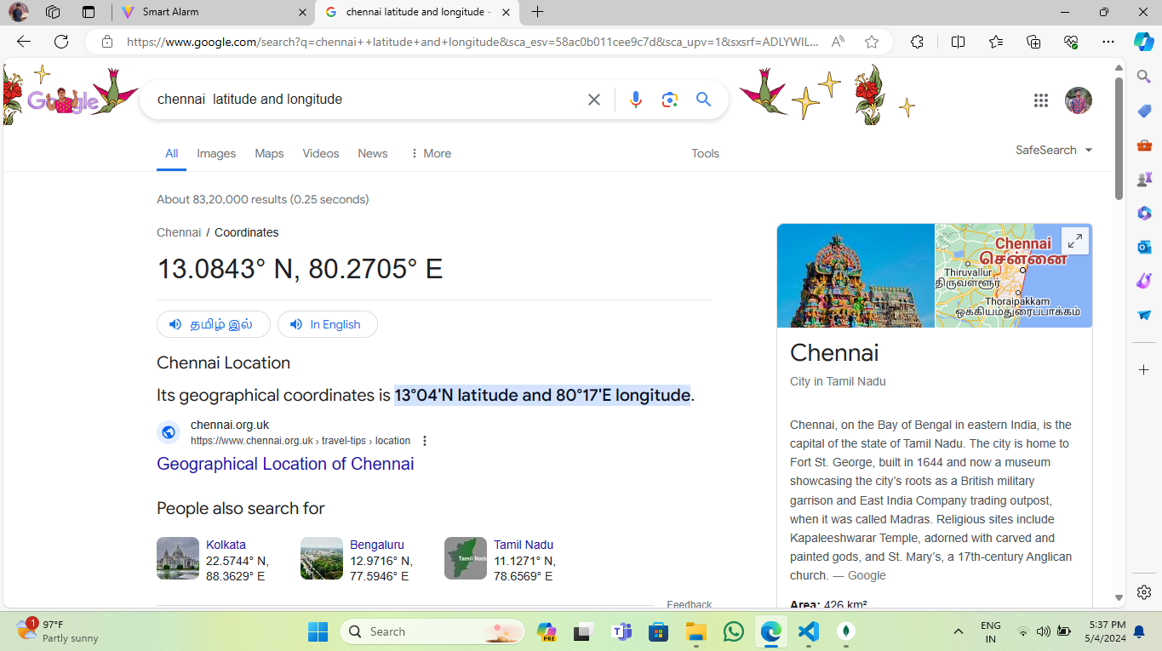

Slide 11
Conclusion and Future Prospects
By make it as an android application with Smart Watches Support. ( 50% work completed).
By making a bot to make call and instruct about the user destination.
Providing more customizable notification sounds.

Slide 12
TEAM MATES
1. SANJAI KUMAR R (IT)
2. SANTOSH CHARAN (IT)
3. KUMARAN S (IT)
4. TAMIL AMIT RAJ (AIDS)

Slide 13
ABSTRACT
Smart Location Alarm is a web application designed to revolutionize the travel experience by providing real-time notifications and calling to users as they approach their destinations.
Leveraging tracking and integration with mapping services, the app ensures users stay informed about their journey progress without distractions.
The primary goals include enhancing convenience, safety, and reliability for travelers.
With customizable distance settings and a commitment to accuracy, Smart Location Alarm aims to simplify travel while prioritizing user privacy and data security.
The project's objectives include enhancing user engagement, optimizing notification accuracy, and ensuring robust security measures to safeguard user data.
With a focus on customization and continuous improvement based on user feedback, Smart Location Alarm aspires to redefine the way people navigate and stay informed while on the move.

Slide 14
THANK YOU

